Slide 1
Lesson 8: Modelling Cyclones

Slide 2
Why do they spin?
The Coriolis Effect: Earth's rotation deflects air.
Southern Hemisphere = CLOCKWISE

Slide 3
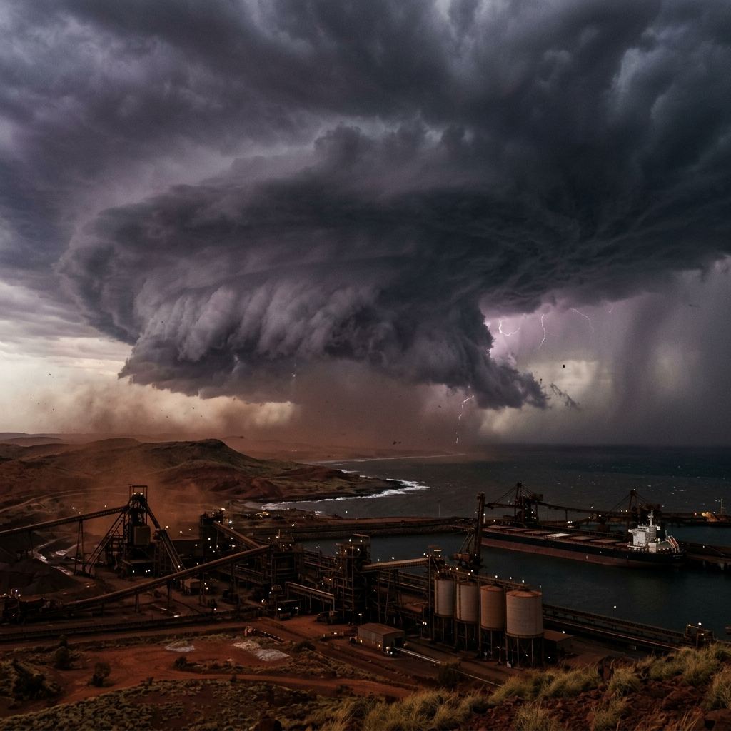
Cyclone George (2007)

Slide 4
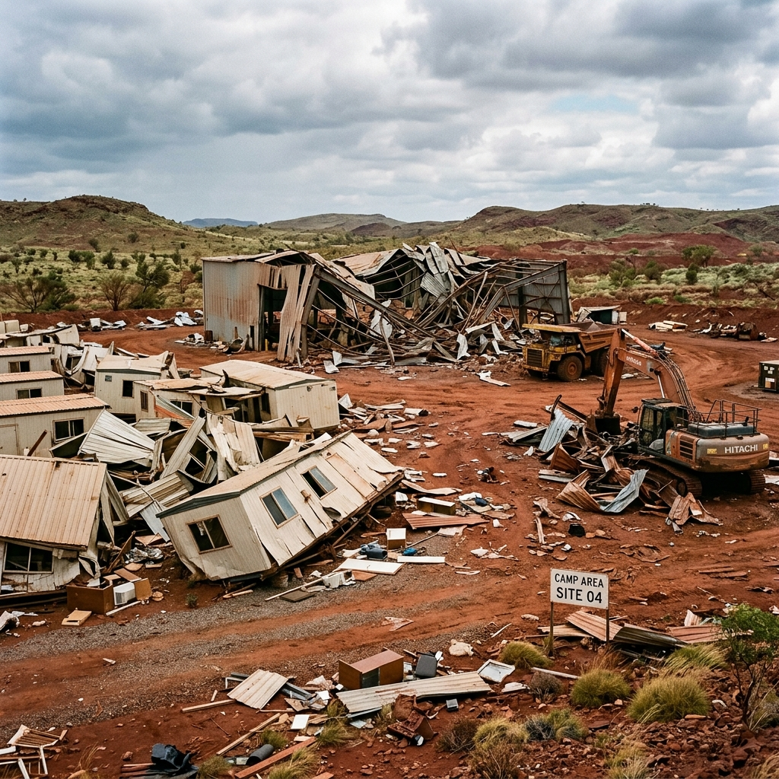
Mining Damage: Cyclone George

Slide 5
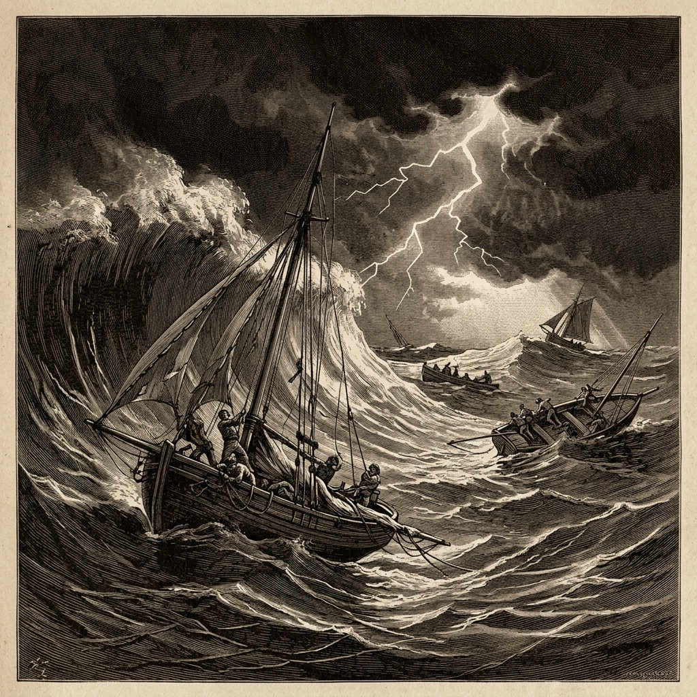
Deadliest: Cyclone Mahina

Slide 6
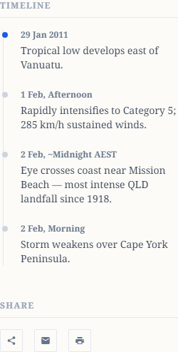
Cyclone History Timeline

